Slide 1
Anomally detectıon modellıng
Group ESPOR
Alperen Yıldız
Aşkın Caner Akkuş
Muhammed Ali Metin
Feyzi Bağbozan
Barış Koç

Slide 2
Exact Choice of Topic
To determine times when the machines perform in anomalistic situations.
Models and Machine Learning algorithms that we use predict anomaly times of the machines.
To determine those anomaly times and constitute preventive maintenance processes.
Two different algorithms of Machine Learning which are;
Unsupervised Artificial Neural Network
Clustering

Slide 3
Resources and References
We took our data from Kaggle. By using the StandardScaler library, data has been normalized by using mean and standard deviation of new position of the machine
https://www.kaggle.com/inIT-OWL/vega-shrinkwrapper-runtofailure-data
We used Self Organizing Maps to analyze the data
https://www.sciencedirect.com/science/article/pii/S221282711830307X

Slide 4
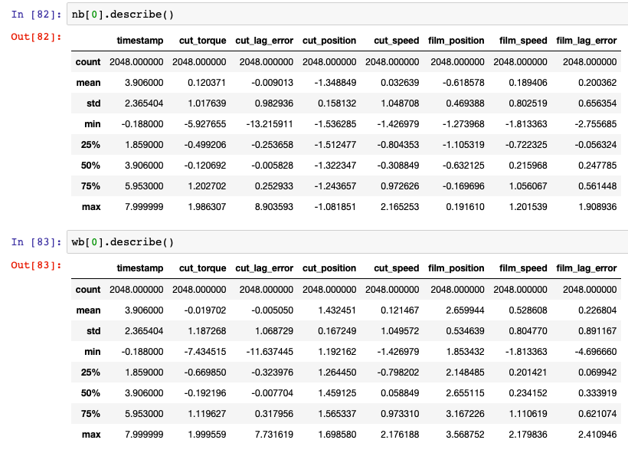
Initial Analysis
Seven variables were used to analyze the performance of machines;
Cut_torque
Cut_lag_error
Cut_position
Cut_speed
Film_position
Film_speed
Film_lag_error
By using the StandardScaler library, data has been normalized by using mean and standard deviation of the normal position of the machine.

Slide 5
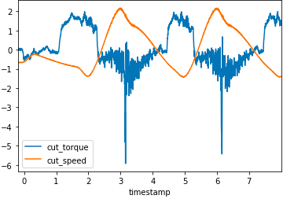
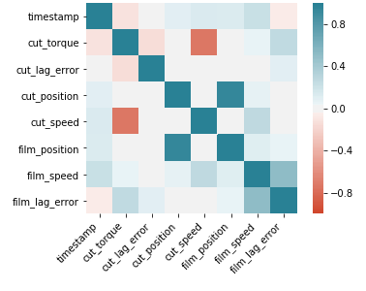
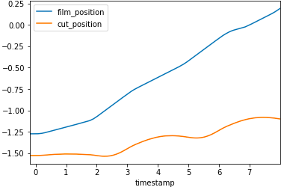
Correlation between variables was analyzed
high negative correlation between cut_torque and cut_speed
high positive correlation between cut_position and film_position

Slide 6
Self Organizing Map
Models that make the operators enable to observe anomalous behaviors of production variables
These models detect anomalous behaviors when there is a significant deviation between in working of the predicted system and the real system
Self-organizing map is a type of artificial neural network

Slide 7
We calculated the total errors of seven variables and plotted it
New Blade
Worn Blade 1
Worn Blade 2
Worn Blade 3

Slide 8
We worked with random batch training approach to learn a self-organizing map from data
The self-organizing maps detect anomalous behaviors by calculating the “quantization error”
If we look at the figure above, film_position variable prone to error
We can predict when the error occurs and which of the variable is behaving abnormally
Experts can intervene the machine at the very first beginning of the degradation

Slide 9
THANK YOU

